Slide 1
1-2 Points, Lines and Planes M11.B.2 2.5.11.B
Objectives:
Understand basic terms of geometry.
Understand basic postulates of geometry.

Slide 2
Vocab
Point- a location with no size, represented by a small dot and is named by a capital letter.
·A
Space- Set of all points
Line – A series of points that extends in two opposite directions without end. You can name a line by any two points on that line, or a single lowercase letter.
t
.
.
B
A

Slide 3
Vocab & Example
Collinear Points – Points that lie on the same line.
Example: Identify Collinear Points
In the figure below, name two points that are collinear and three points that are not collinear.
.
X
.
.
.
Y
Z
W

Slide 4
Vocab
Plane – A flat surface that has no thickness. You can name it by either a single capital letter or by at least 3 noncollinear points.
Coplaner – Points and lines in the same plane.
P
B
C
A
Plane P
Plane ABC

Slide 5
Example 2: Naming a Plane
Name this plane in 3 different ways.
U
S
R
T

Slide 6
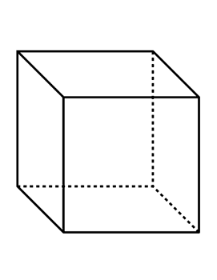
Naming a Plane - 3D Figure

Slide 7
Vocab
Postulate or axiom – is an accepted statement of fact.
Postulate 1-1 – Through any two points there is exactly one line.
.
B
.
A
t

Slide 8
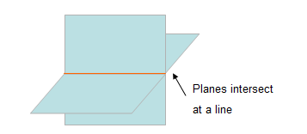
Vocab
Postulate 1 – 2 –If two lines intersect, then they intersect in exactly one point.
Postulate 1- 3 – If two planes intersect, then they intersect in exactly one line.

Slide 9
Example 3: Finding the Intersection of Two Planes
Use the diagram to find the intersection of plane HGC and plane AED?
H
G
E
F
D
C
A
B

Slide 10
Postulate 1-4 & Example
Through any three noncollinear points there is exactly one plane.
Example: Using Postulate 1-4

